Slide 1
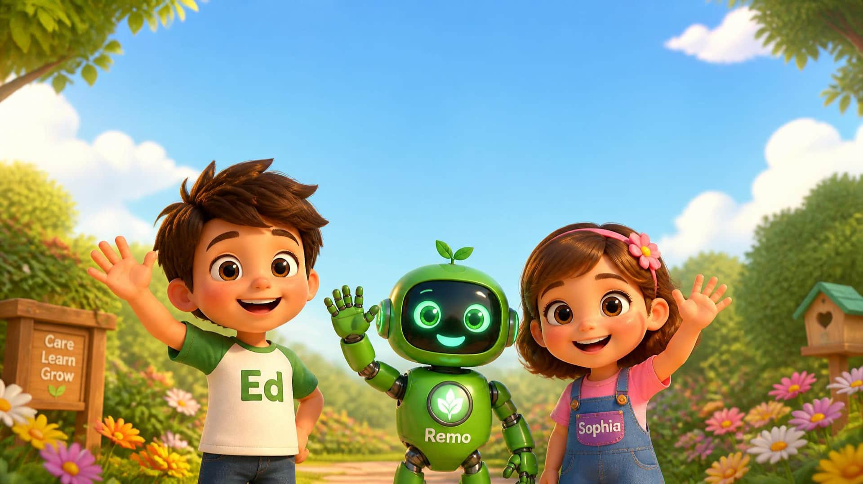

1 / 13
LESSON 4 - DRAWING STRAIGHT DOWN
Say: “Hello, Little Seeds!” Wave and invite everyone to wave back.
LITTLE SEEDS! MONTH 1

Slide 2

2 / 13
Look up!
Point up together. Ask: “What is in the sky?”
LITTLE SEEDS! MONTH 1

Slide 3







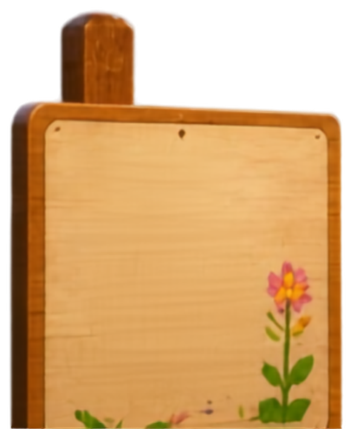








3 / 13
Rain.
Rain
Helps
Things
Grow!
ed
Be kind
to nature
Listen: rain. Say it together — “Rain.”
LITTLE SEEDS! MONTH 1
RimberioFi

Slide 4

4 / 13
Down, down, down.
Wiggle fingers from high to low. Move and say: “Down, down, down.”
LITTLE SEEDS! MONTH 1

Slide 5
5 / 13
Trace down.
★
Get your magic finger ready! Trace down, down, down!
LITTLE SEEDS • M1 L4 • DRAWING STRAIGHT DOWN
05
LITTLE SEEDS! MONTH 1

Slide 6
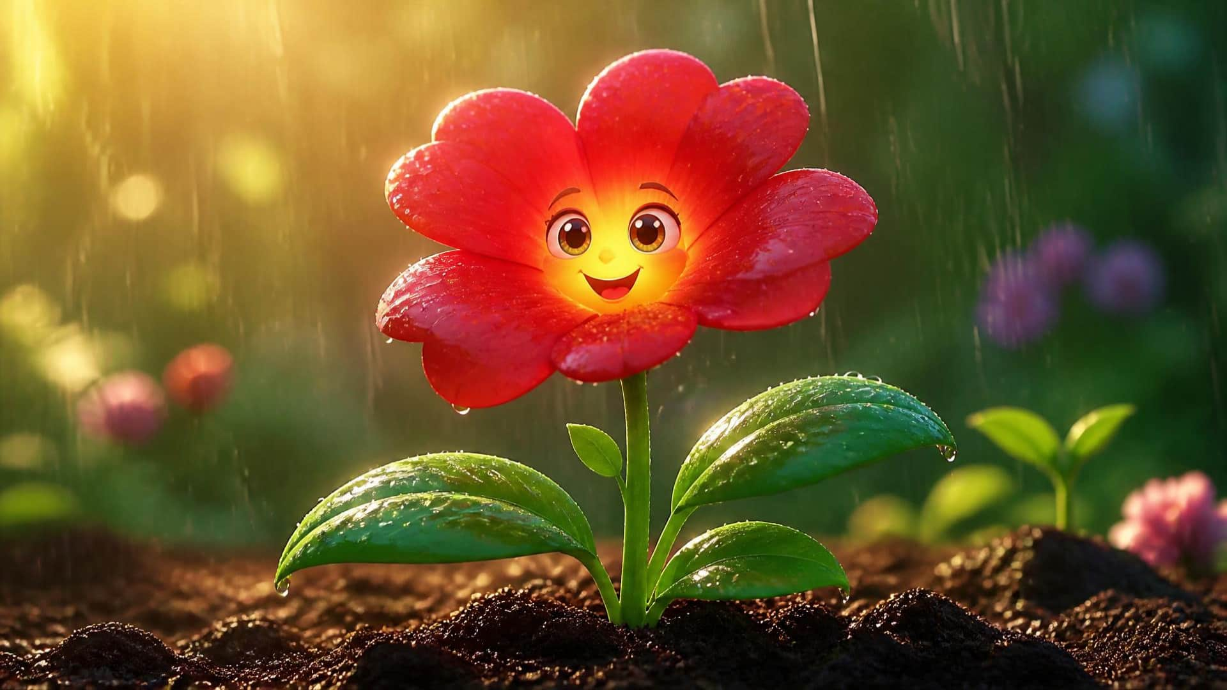
6 / 13
Drink the rain, flower!
Rain gives our flower water. Show how the flower stands tall.
LITTLE SEEDS! MONTH 1

Slide 7
7 / 13
Draw straight down.
☁
☁
☁
✿
✿
✿
Can you help the rain reach the flowers? Touch and draw down!
LITTLE SEEDS • M1 L4 • DRAWING STRAIGHT DOWN
07
LITTLE SEEDS! MONTH 1

Slide 8
8 / 13
God sends the rain.
Ask: “Who gives the flowers water?” Say: “Thank you, God!”
LITTLE SEEDS! MONTH 1

Slide 9
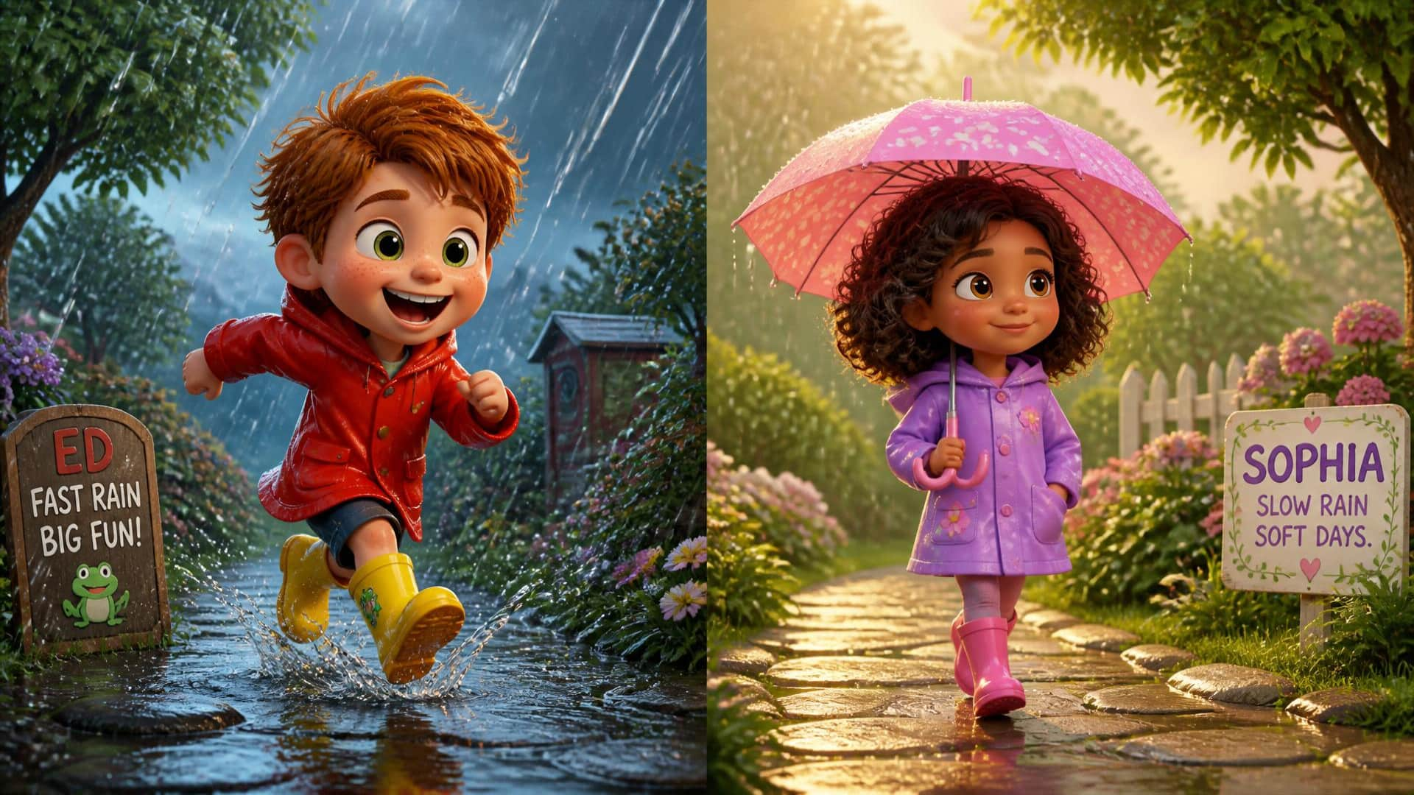
9 / 13
Fast or Slow?
Trace fast for fast rain. Trace slowly for slow rain. Try both!
LITTLE SEEDS! MONTH 1

Slide 10
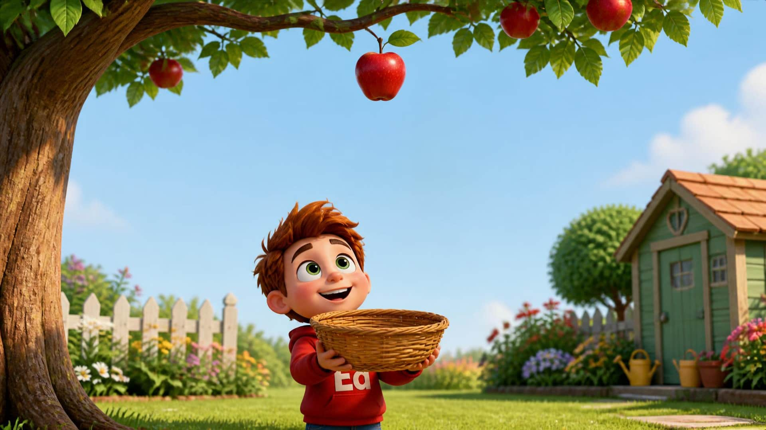
10 / 13
Apple falls down.
Trace the apple: “Down, down, down!”
LITTLE SEEDS! MONTH 1

Slide 11
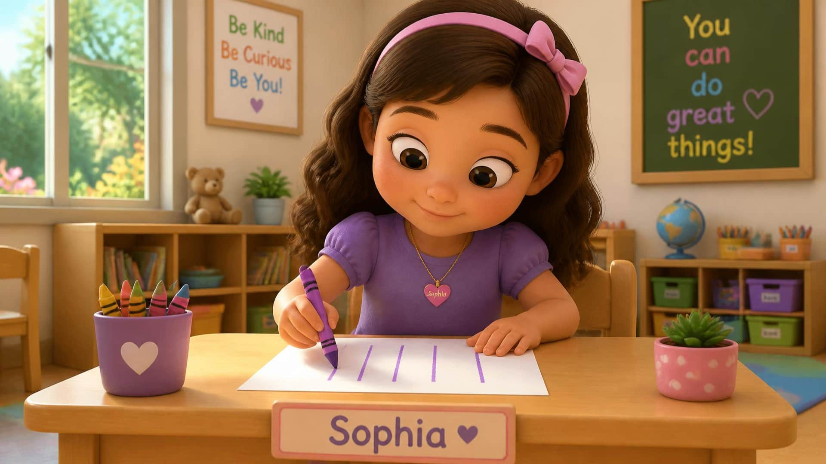
11 / 13
Your turn!
Take paper and a crayon. Draw straight lines from top to bottom.
LITTLE SEEDS! MONTH 1

Slide 12
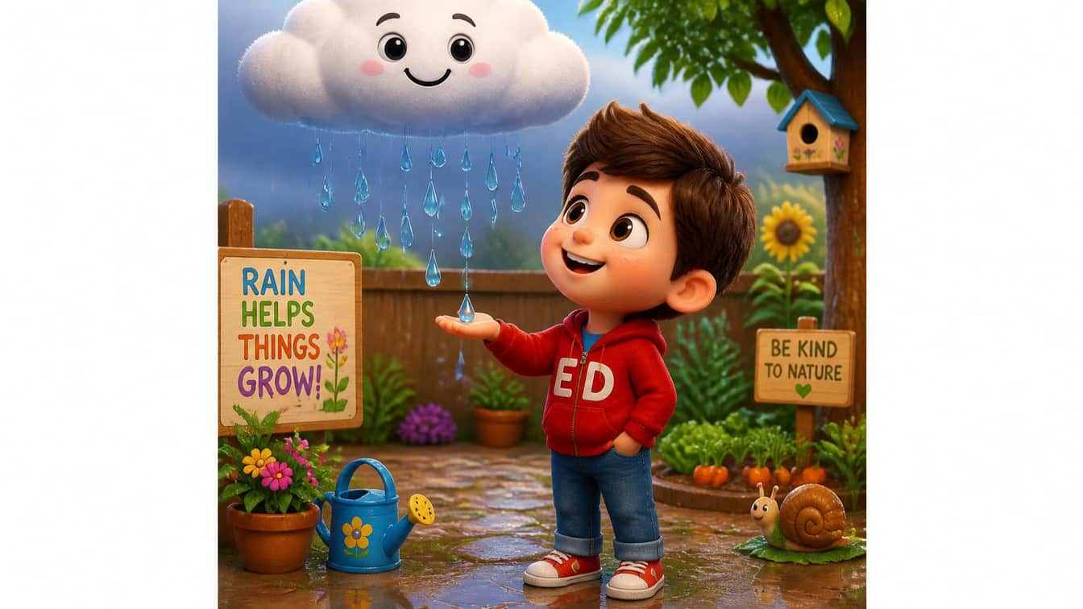
12 / 13
Rain. Down, down, down.
RAIN
FLOWER
Say “Rain.” Move your finger straight down. What drinks the rain?
12
LITTLE SEEDS! MONTH 1

Slide 13
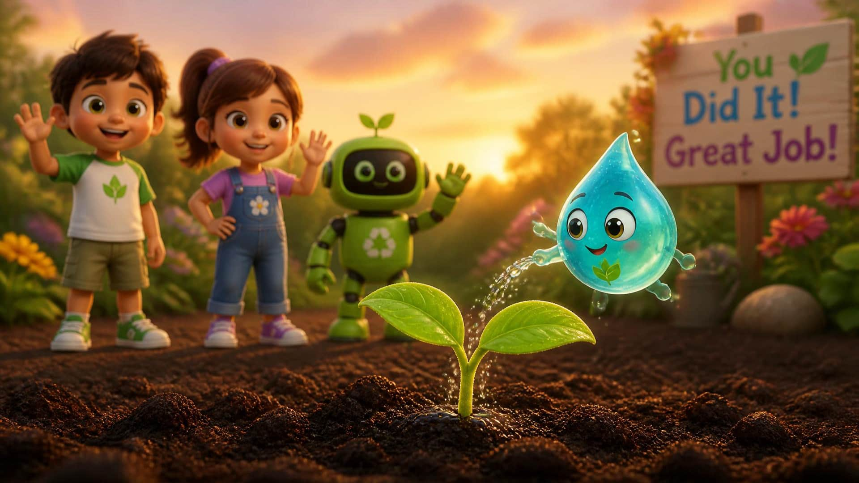
13 / 13
Goodbye!
You earned an Eco-Drop! Celebrate, thank the children, and wave goodbye.
LITTLE SEEDS! MONTH 1

